Slide 1
Studiu de caz : Windows
Chapter 11

Slide 2
Windows NT
Element | Windows 95/98 | Windows NT
Sistem pe 32 de biti complet? | NU | DA
Securitate | NU | DA
Punerea in corespondenta protejata a fisierelor? | NU | DA
Spatiu de adrese privat pt fiecare progrm MS-DOS | NU | DA
Unicode? | NU | DA
Suporta mai multe CPU | NU | DA
Cod reentrant in SO | NU | DA
Plug and Play | DA | NU
Optiune de alimentare | DA | NU
Sistem de fisiere Fat 32 | DA | Optional
Sistem de fisiere NTFS | NOU | DA
Win32 API | DA | DA
Ruleaza toate progr MSDOS vechi | DA | NU
Exista date critice ale SO ce pot fi scrise de catre utilizator | DA | NU

Slide 3
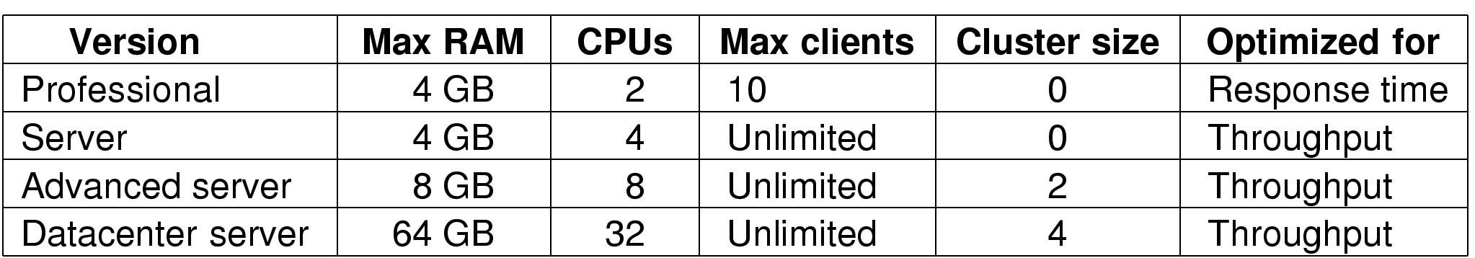
Windows 2000 (1)
Diferite versiuni ale Windows 2000

Slide 4
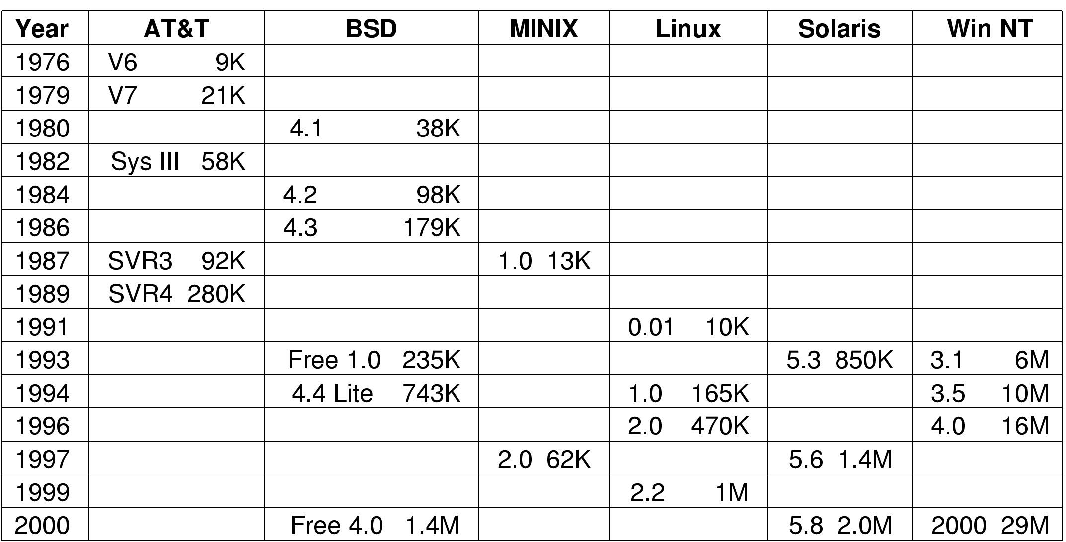
Windows 2000 (2)
Comparatie a dimensiunii SO

Slide 5
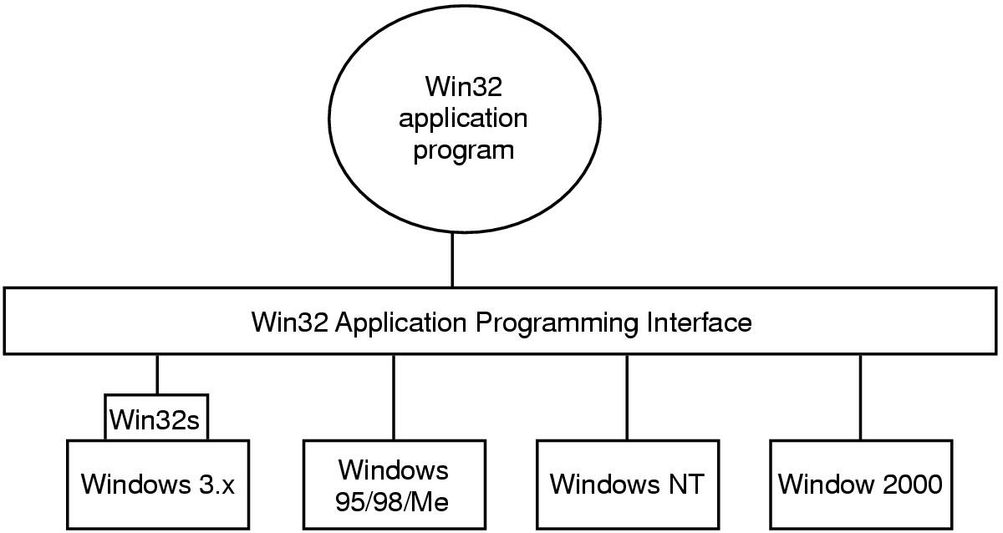
The Win32 Application Programming Interface
Win32 API lasa programele sa ruleze sub cele mai multe versiuni de Windows

Slide 6
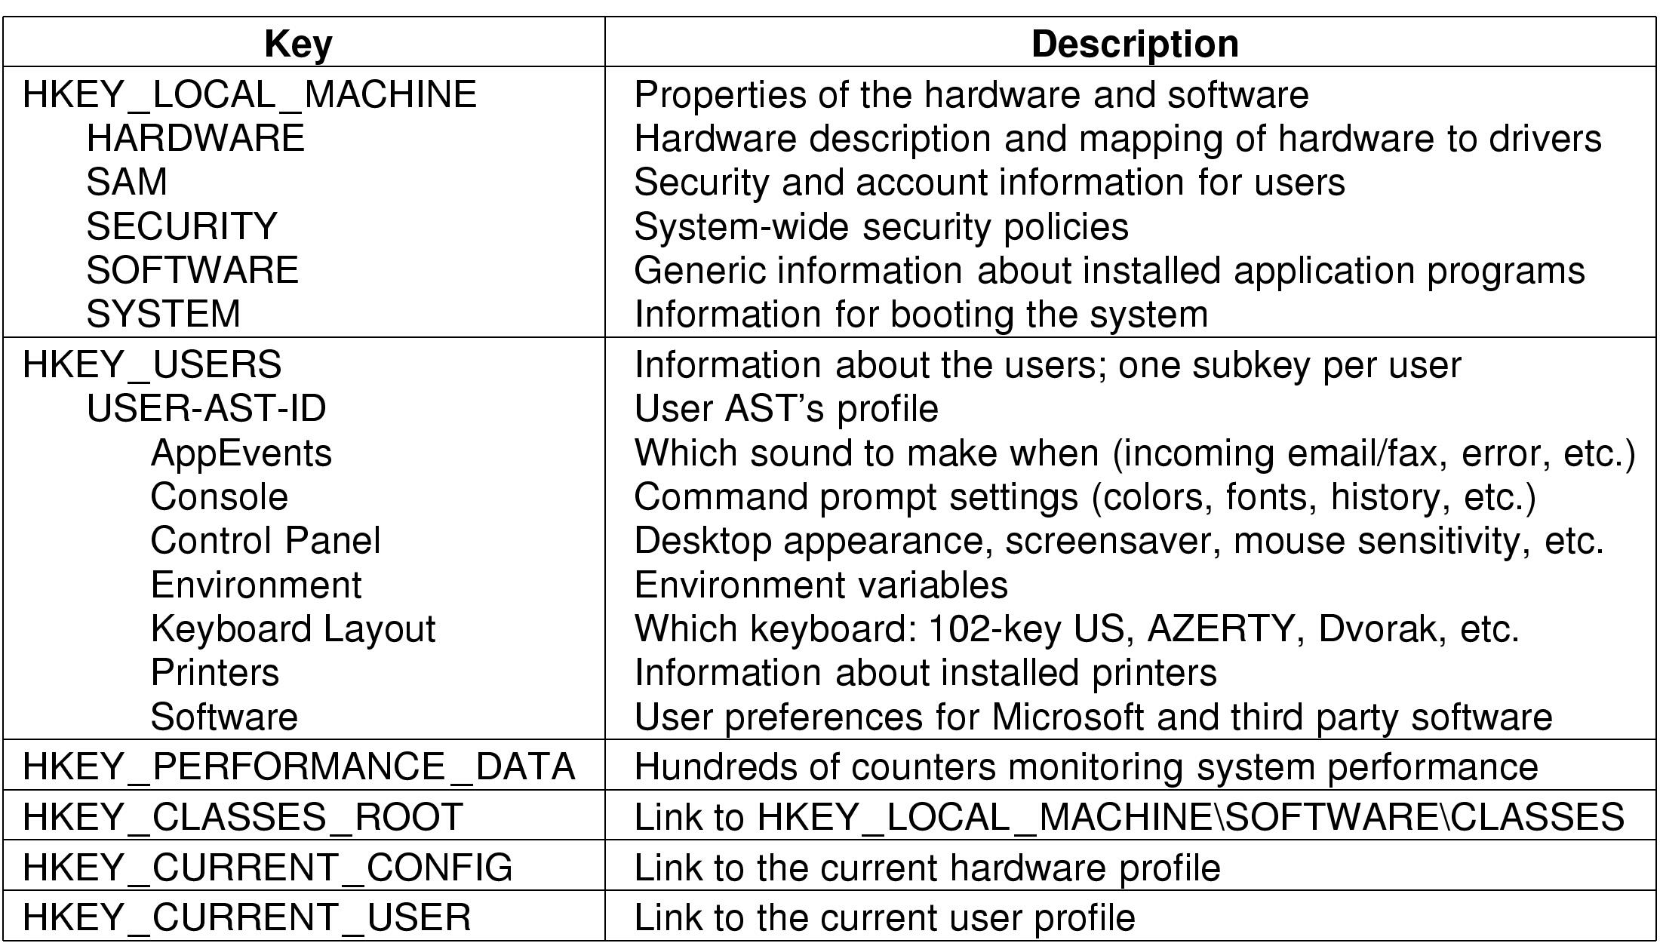
The Registry (1)

Slide 7
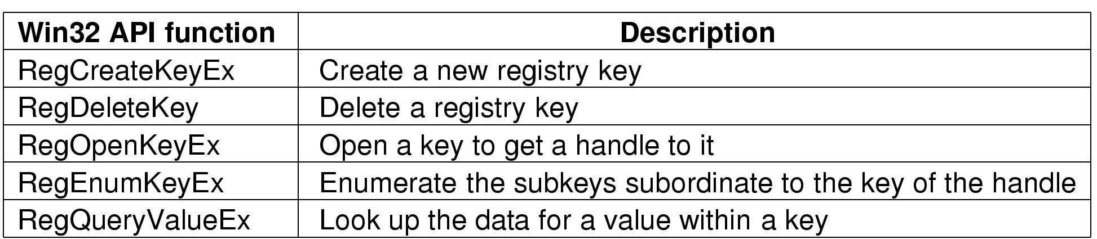
The Registry (2)
Unele cereri din Win32 API care utilizeaza registri

Slide 8
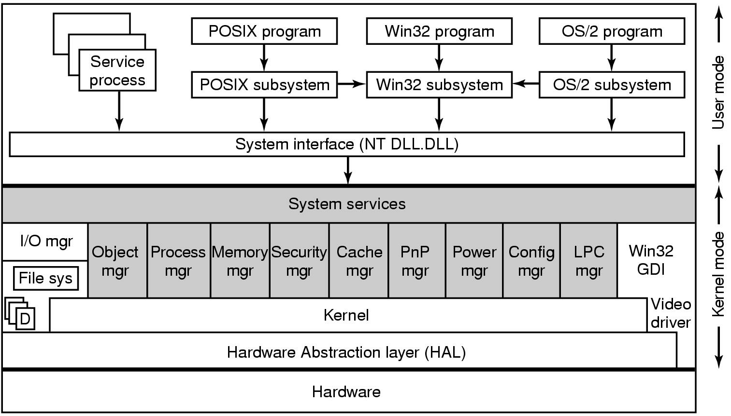
Structura Sistemului de Operare
Structure Windows 2000 (simplificata).
Zonele hasurate reprezinta executivul
D - drivere
Procesele sistem sunt daemoni sistem

Slide 9
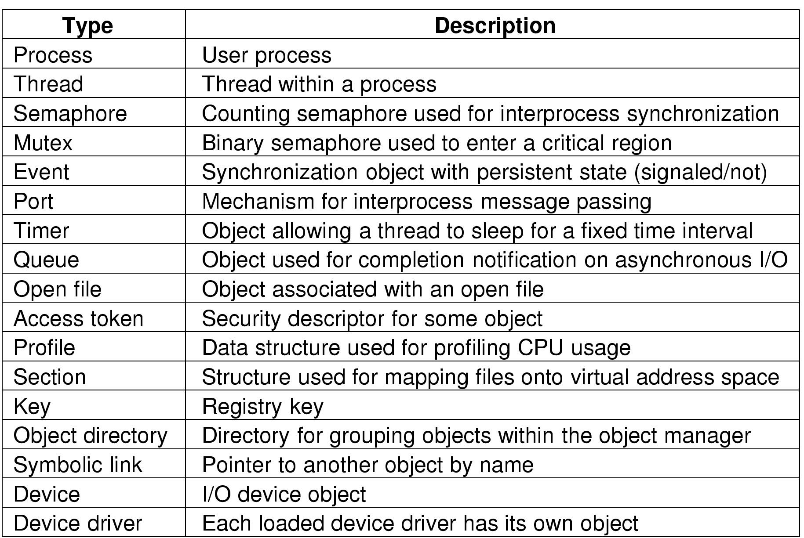
Implementarea de Obiecte
cele mai comune tipuri de obiecte executabile gestionate de managerul de obiecte

Slide 10
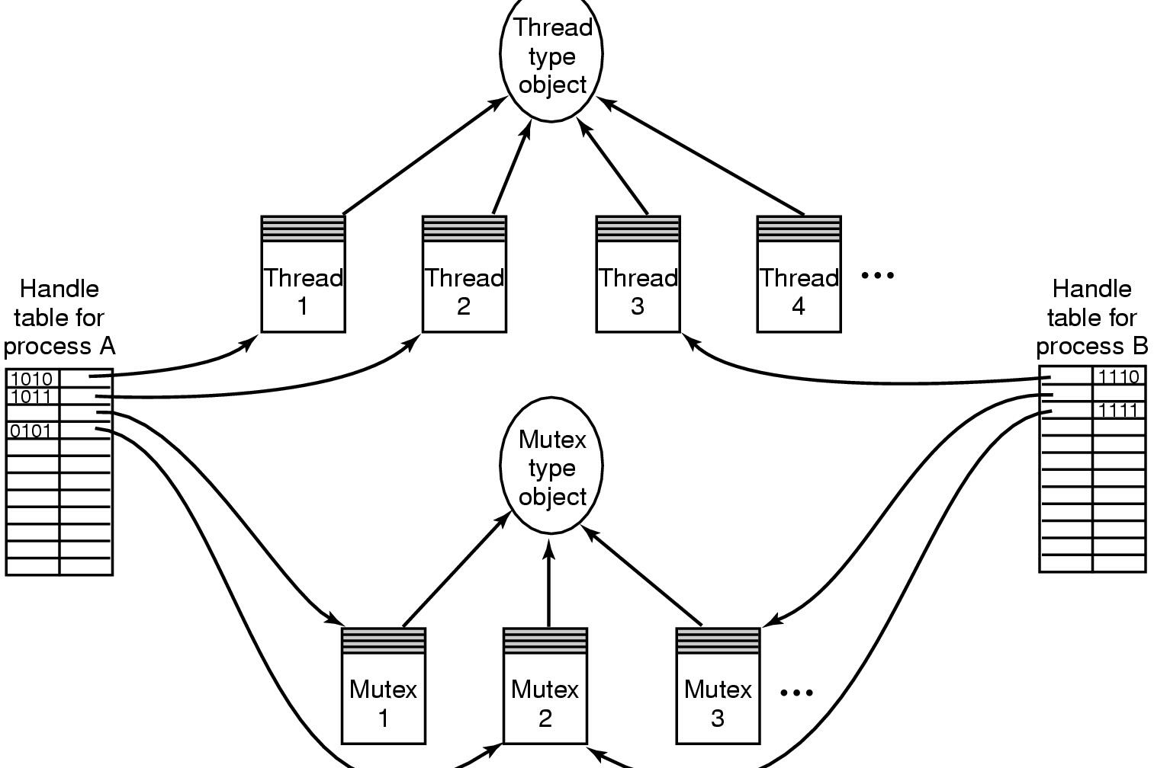
Implementarea de Obiecte
Relatiile intre tabele de referinta, obiecte si obiecte de tip

Slide 11
Procese si Fire de executie (1)
Nume | Descriere
JOB | Colectie de procese care partajeaza cote si limite
Proces | Container pentru pastrarea resurselor
Fir de executie | O entitate planificata de nucleu
Fibra | Fir de executie usor gestionat in intregime in spatiul utilizator

Slide 12
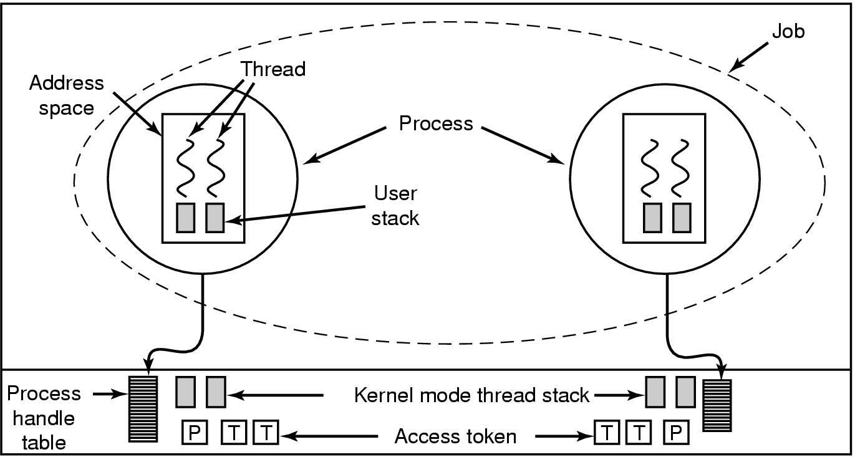
Procese si Fire de executie (2)
Relatii intre job-uri, procese, fire de executie, and fibre

Slide 13
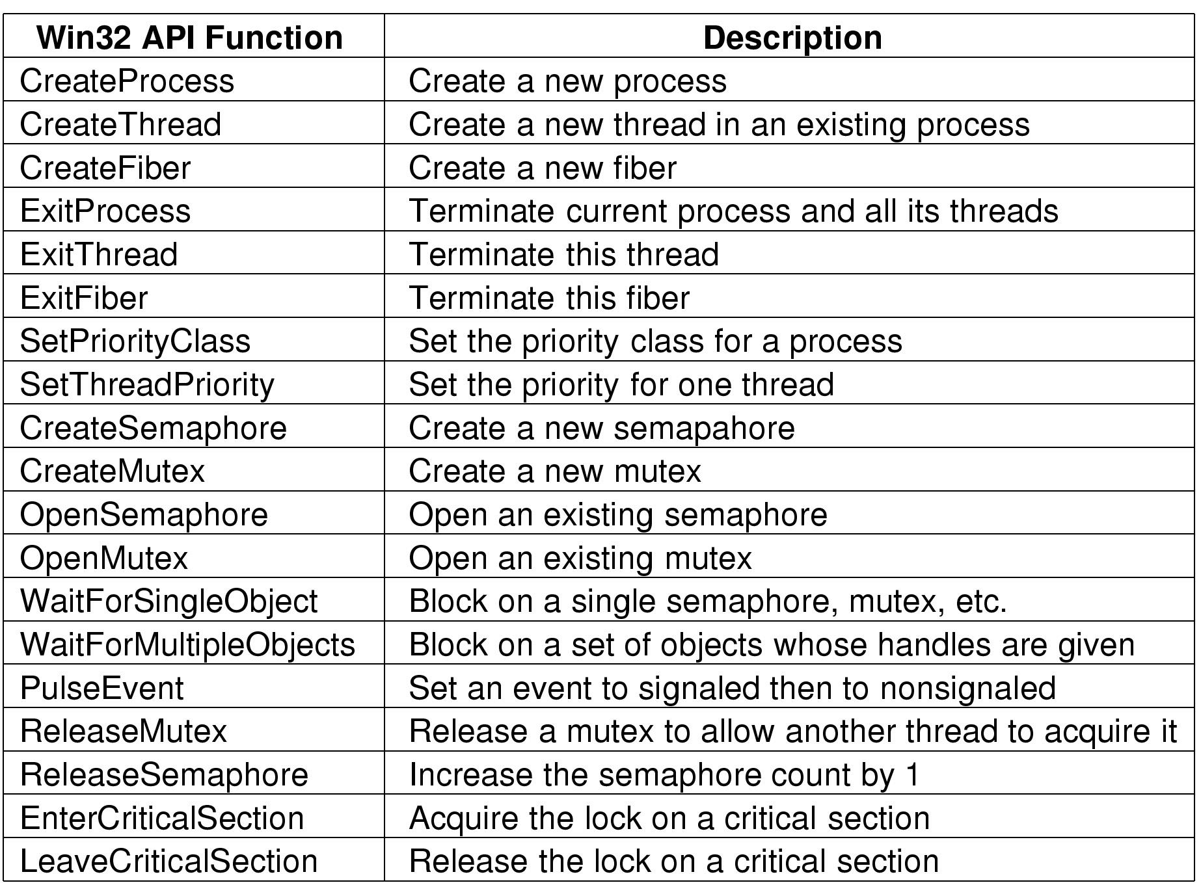
Job, Process, Thread & Fiber Mgmt. API Calls
Some of Win32 calls for managing processes, threads and fibers

Slide 14
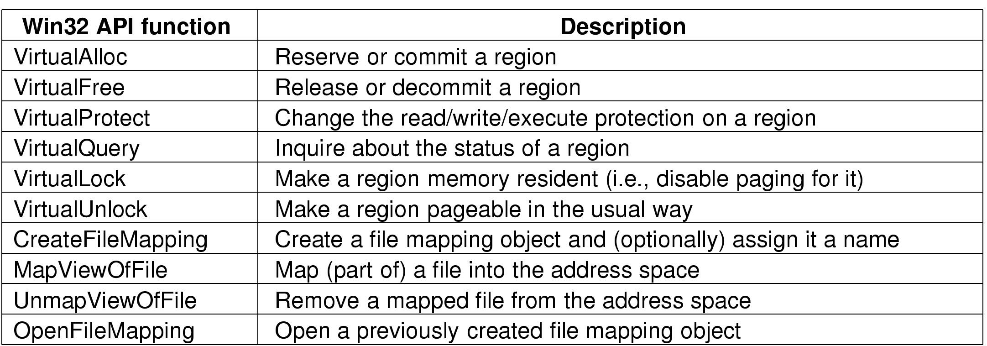
Memory Management System Calls
The principal Win32 API functions for mapping virtual memory in Windows 2000

Slide 15
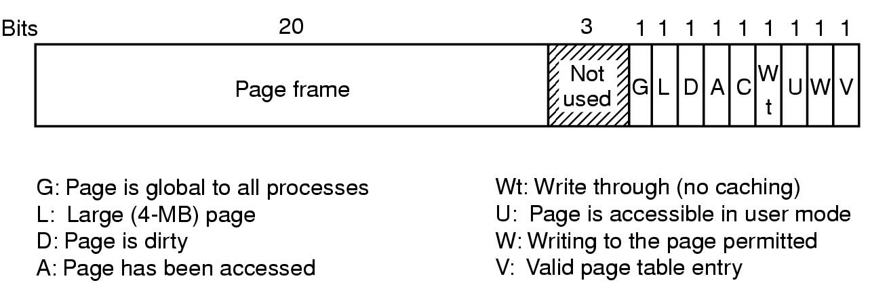
Implementarea Managementulu de Memorie
O intrarre in tabela de pagini pentru o pagina pusa in corespondenta pe Pentium

Slide 16
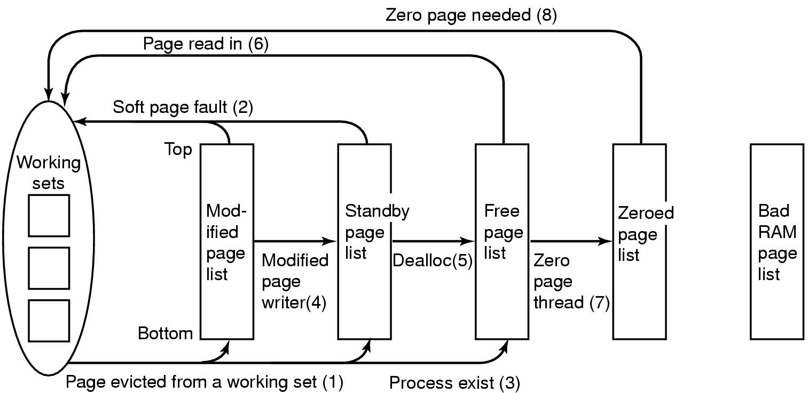
Physical Memory Management (1)
The various page lists and the transitions between them

Slide 17
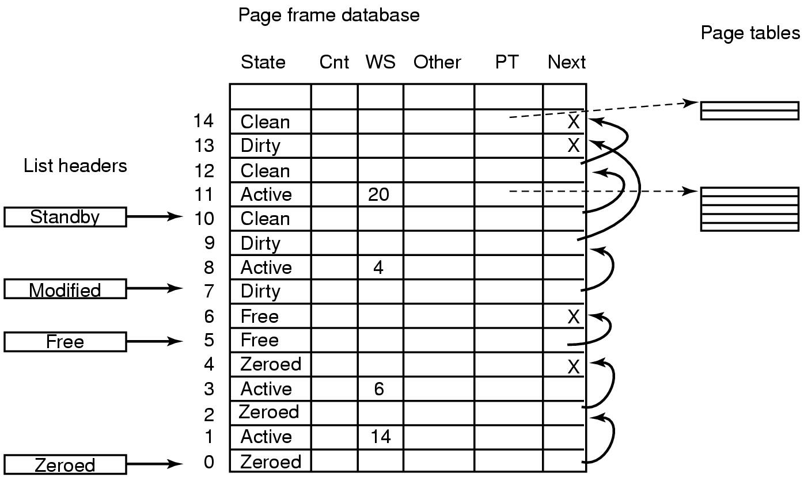
Physical Memory Management (2)
Some of the major fields in the page frame data base for a valid page

Slide 18
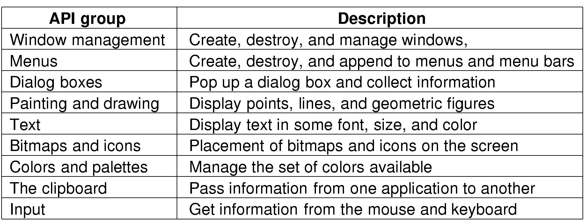
Input/Output API Calls
Categories of Win32 API calls

Slide 19
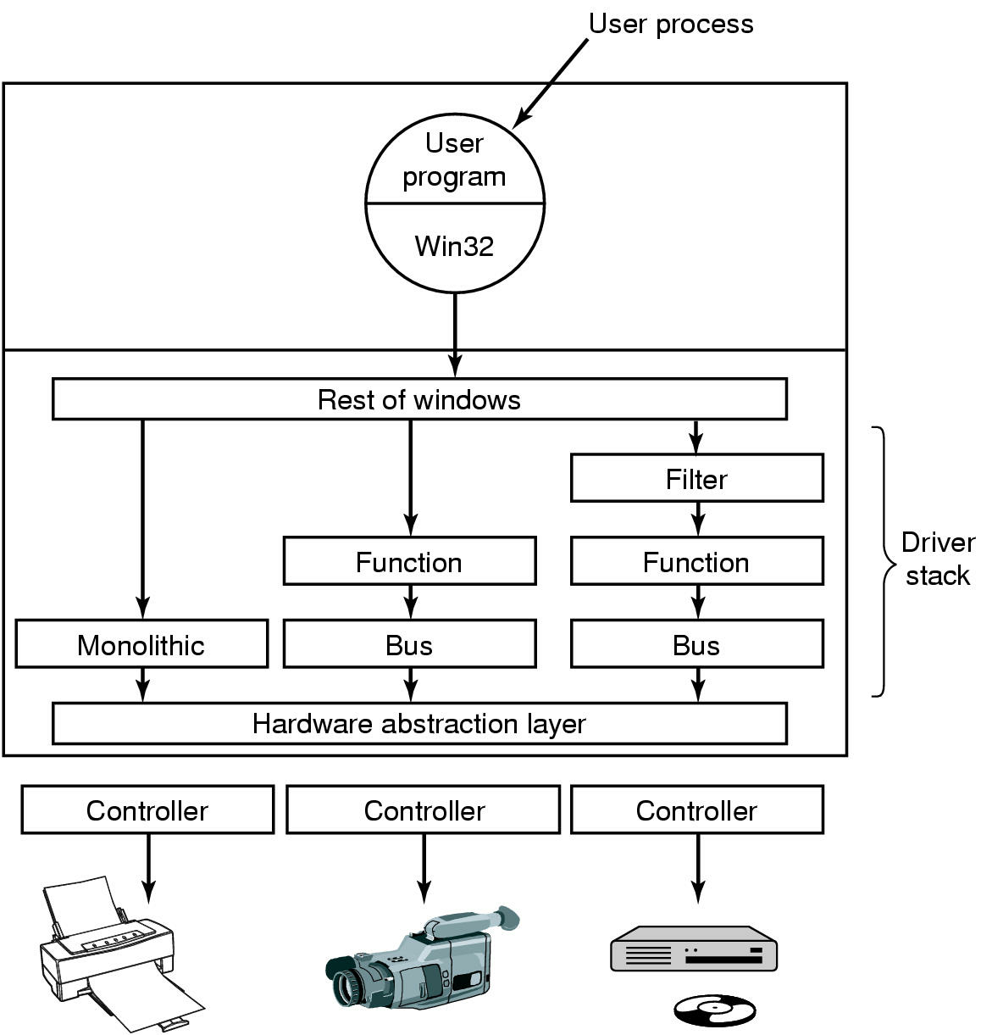
Device Drivers
Windows 2000 allows drivers to be stacked

Slide 20
KB946765
Architectura | Windows Vista, 32-biti | Windows Vista, 64-biti
System requirements | 1-gigahertz (GHz) 32-bit (x86) processor sau 64-bit (x64) processor, 512 MB of RAM | 1-GHz 64-bit (x64) processor, 1 GB of RAM (4 GB recommended)
Memory access | Poate accesa pana la 4 GB din RAM. | Poate accesa de la 1 GB din RAM pana la 128 GB din RAM.
Memory access per edition | Toate versiunile pot accesa pana la 4 GB din RAM | Windows Vista Home Basic - 8 GB din RAM Windows Vista Home Premium - 16 GB din RAM Windows Vista Business - 128 GB din RAM sau mai mult Windows Vista Enterprise - 128 GB din RAM sau mai mult Windows Vista Ultimate - 128 GB din RAM sau mai mult

Slide 21
DEP | 32-bit versions of Windows Vista use a software-based version of DEP. | 64-bit versions of Windows Vista support hardware-backed DEP.
Kernel Patch Protection (PatchGuard) | This feature is not available in 32-bit versions of Windows Vista. | This feature is available in 64-bit versions of Windows Vista. Kernel Patch Protection helps prevent a malicious program from updating the Windows Vista kernel. This feature works by helping to prevent a kernel-mode driver from extending or replacing other kernel services. Also, this feature helps prevent third-party programs from updating (patching) any part of the kernel.
Driver signing | Unsigned drivers may be used with 32-bit versions of Windows Vista. | 64-bit versions of Windows Vista require that all device drivers be digitally signed by the developer.
32-bit driver support | 32-bit versions of Windows Vista support 32-bit drivers that are designed for Windows Vista. | 64-bit versions of Windows Vista do not support 32-bit device drivers.
16-bit program support | 32-bit versions of Windows Vista support 16-bit programs, in part. | 64-bit versions of Windows Vista do not support 16-bit programs.

Slide 22
Windows Vista
Windows Vista Business
Windows Vista Enterprise
Windows Vista Home Basic
Windows Vista Home Premium
Windows Vista Ultimate
Windows Vista Enterprise 64-bit Edition
Windows Vista Home Basic 64-bit Edition
Windows Vista Home Premium 64-bit Edition
Windows Vista Ultimate 64-bit Edition
Windows Vista Business 64-bit Edition

Slide 23
Ubuntu vs Vista vs Windows 7 sursa: http://www.tuxradar.com/node/33
Care a fost timpul de instalare?
Cat spatiu a fost necesar la instalarea standard?
Cat timp ia la pornire si oprire?
Care este timpul de copiere a fisierelor de pe USB pe HD, si de pe HD to HD?
How fast can it execute the Richards benchmark?

Slide 24
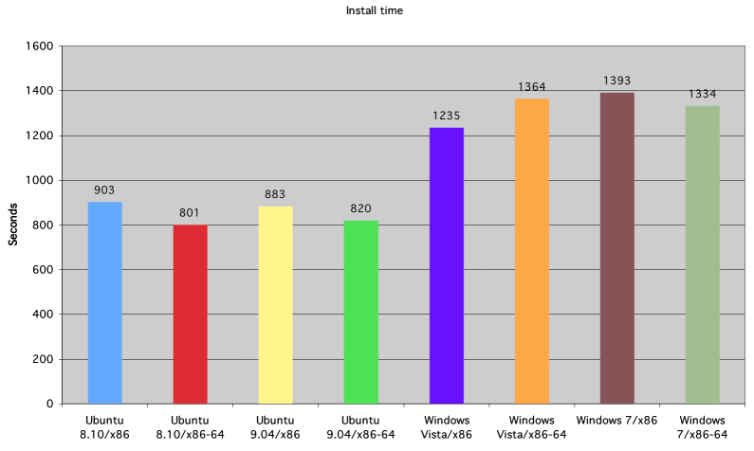
Timpul de instalare

Slide 25
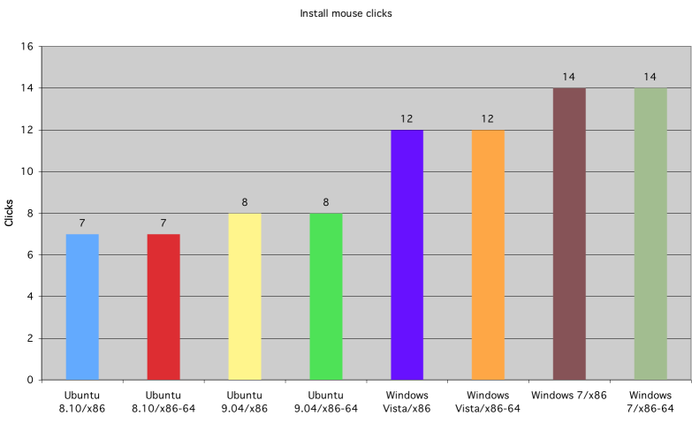
Mouse Click install

Slide 26
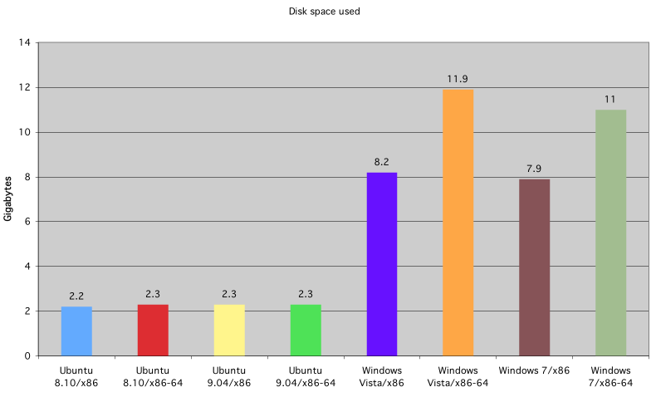
Spatiul Utilizat

Slide 27
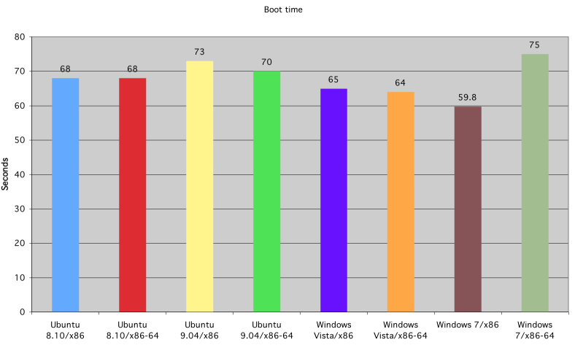
Timpul de pornire

Slide 28
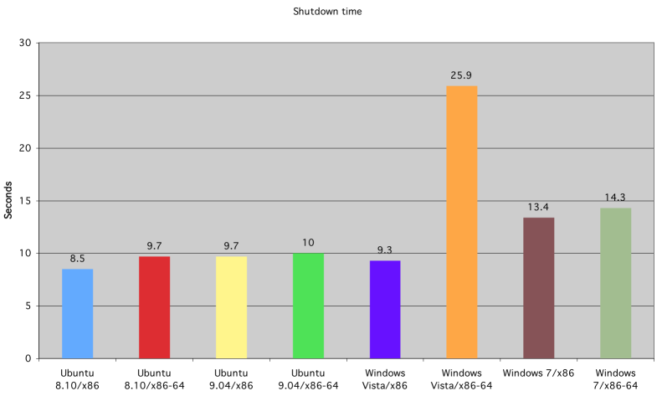
Timpul de oprire

Slide 29
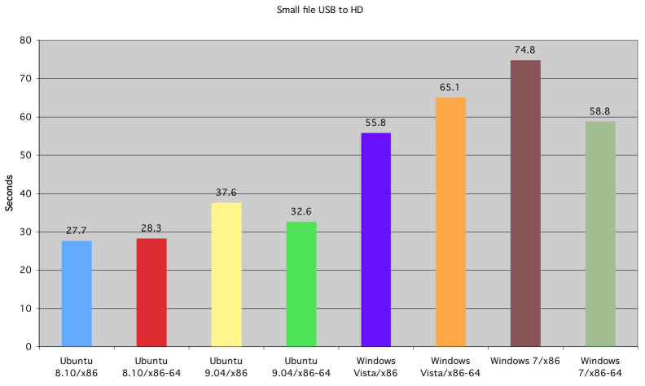
Fisiere mici de pe USB pe HD

Slide 30
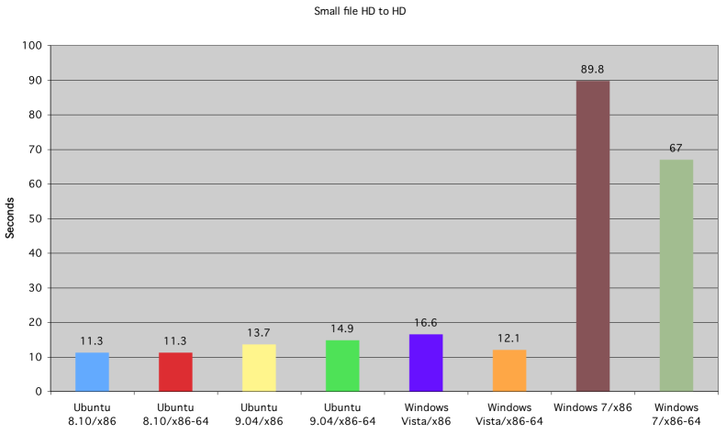
Fisiere mici de pe HD pe HD

Slide 31
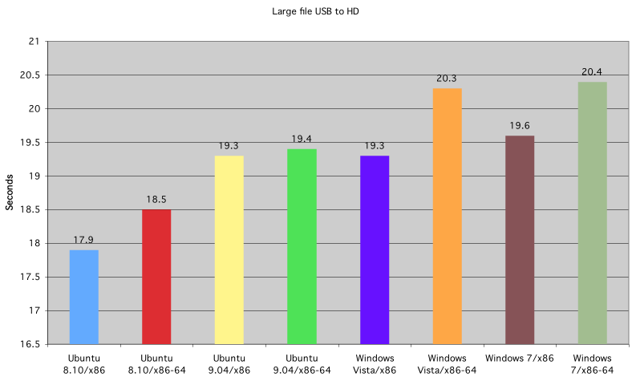
Fisiere mari de pe USB pe HD

Slide 32
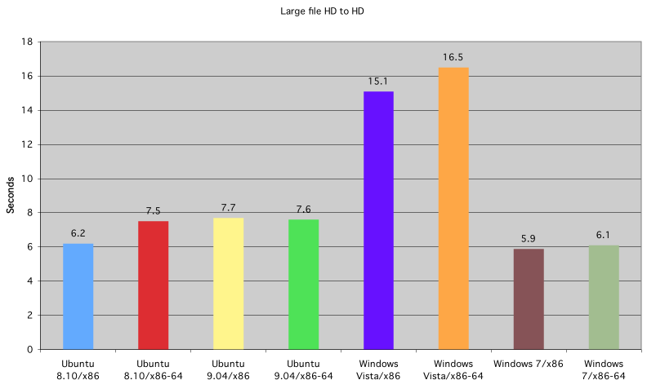
Fisiere mari de pe HD pe HD

